Slide 1
Comparison
Barycentric Coordinates
vs
Generalized Barycentric Coordinates (Wachspress Coordinates)
vs
Generalized Mean Value Coordinates

Slide 2









Slide 3


Generalized Mean Value Coordinates
Wachspress Coordinate or Generalized Barycentric Coordinates

Slide 4
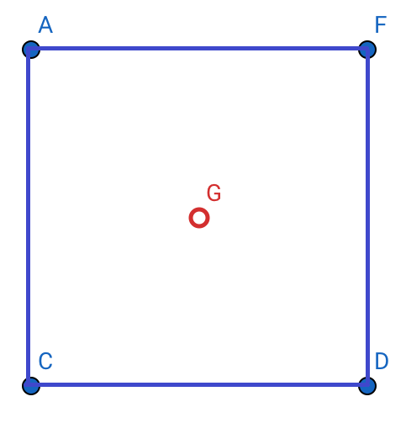
 | Generalized MV Coordinates | Barycentric Coordinates | Generalized Barycentric Coordinates
A | 25 | 25 | 25
C | 25 | 25 | 25
D | 25 | 25 | 25
F | 25 | 25 | 25
 | 100 | 100 | 100
Total

Slide 5
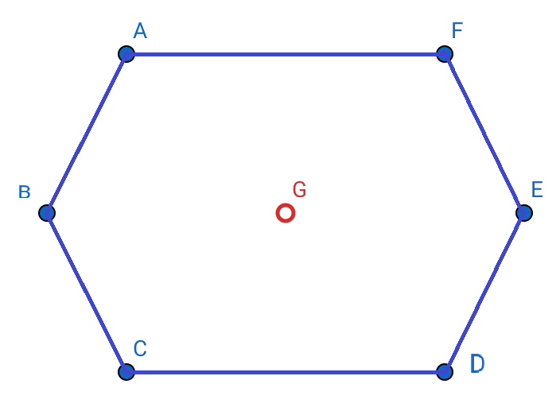
 | Generalized MV Coordinates | Barycentric Coordinates | Generalized Barycentric Coordinates
A | 19.5903 | 18.75 | 18.75
B | 10.8194 | 12.5 | 12.5
C | 19.5903 | 18.75 | 18.75
D | 19.5903 | 18.75 | 18.75
E | 10.8194 | 12.5 | 12.5
F | 19.5903 | 18.75 | 18.75
 | 100 | 100 | 100
Total

Slide 6
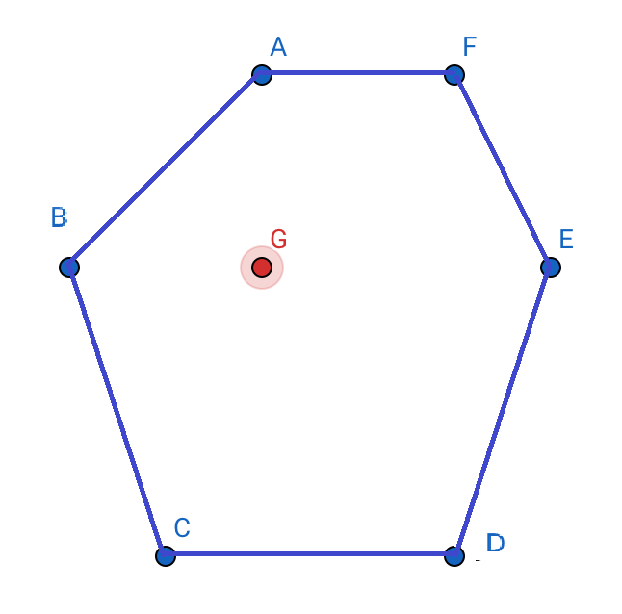
 | Distance from G | Generalized MV Coordinates | Barycentric Coordinates | Generalized Barycentric Coordinates
A | 2 | 24.8674 | 22.314 | 22.314
B | 2 | 30.2576 | 29.7521 | 29.7521
C | 3.162 | 13.4547 | 14.876 | 14.876
D | 3.61 | 9.99049 | 9.91736 | 9.91736
E | 3 | 11.1294 | 8.26446 | 8.26446
F | 2.83 | 10.3004 | 14.876 | 14.876
 |  | 100 | 100 | 100
Total

Slide 7
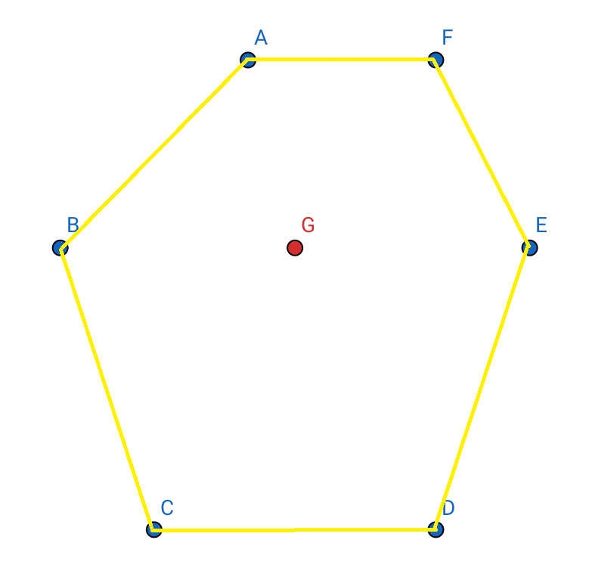
 | Distance from G | Generalized MV Coordinates | Barycentric Coordinates | Generalized Barycentric Coordinates
A | 2.06 | 22.8028 | 19.7368 | 19.7368
B | 2.5 | 20.9293 | 21.0526 | 21.0526
C | 3.35 | 12.4685 | 13.1579 | 13.1579
D | 3.35 | 12.4685 | 13.1579 | 13.1579
E | 2.5 | 16.7282 | 13.1579 | 13.1579
F | 2.5 | 14.6027 | 19.7368 | 19.7368
 |  | 100 | 100 | 100
Total

Slide 8
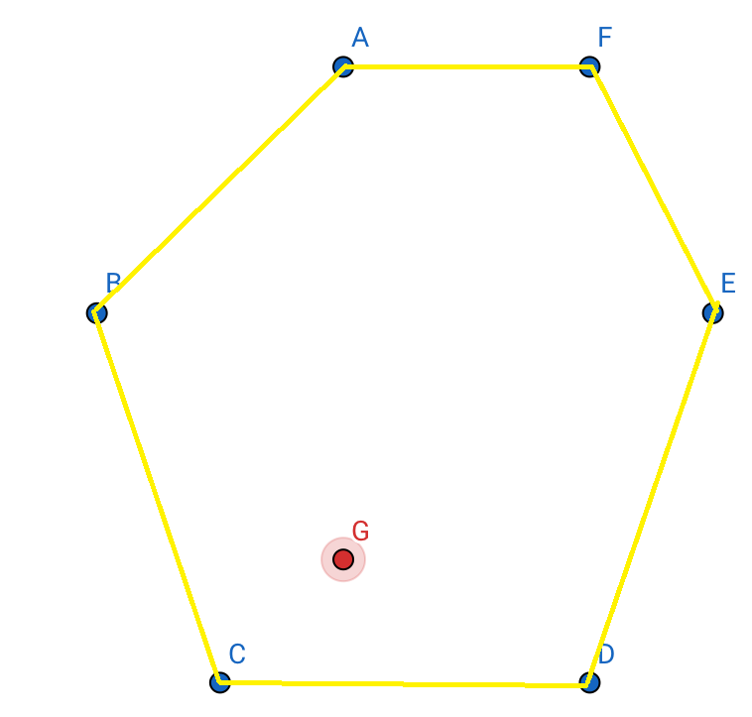
 | Distance from G | Generalized MV Coordinates | Barycentric Coordinates | Generalized Barycentric Coordinates
A | 4 | 4.54423 | 3.80435 | 3.80435
B | 2.83 | 13.9762 | 15.2174 | 15.2174
C | 1.41 | 47.1882 | 45.6522 | 45.6522
D | 2.24 | 24.5982 | 26.087 | 26.087
E | 3.61 | 6.55782 | 5.43478 | 5.43478
F | 4.47 | 3.13537 | 3.80435 | 3.80435
 |  | 100 | 100 | 100
Total

Slide 9
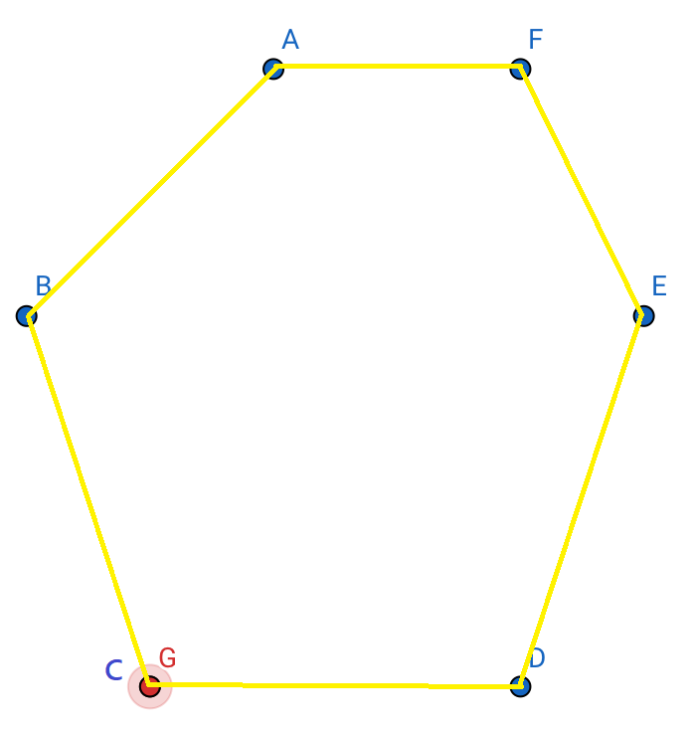
 | Distance from G | Generalized MV Coordinates | Barycentric Coordinates | Generalized Barycentric Coordinates
A | 5.1 | 0 | 0 | 0
B | 3.16 | 0 | nan | 0
C | 0 | 100 | nan | 100
D | 3 | 0 | nan | 0
E | 5 | 0 | 0 | 0
F | 5.83 | 0 | 0 | 0
 |  | 100 | nan | 100
Total

Slide 10
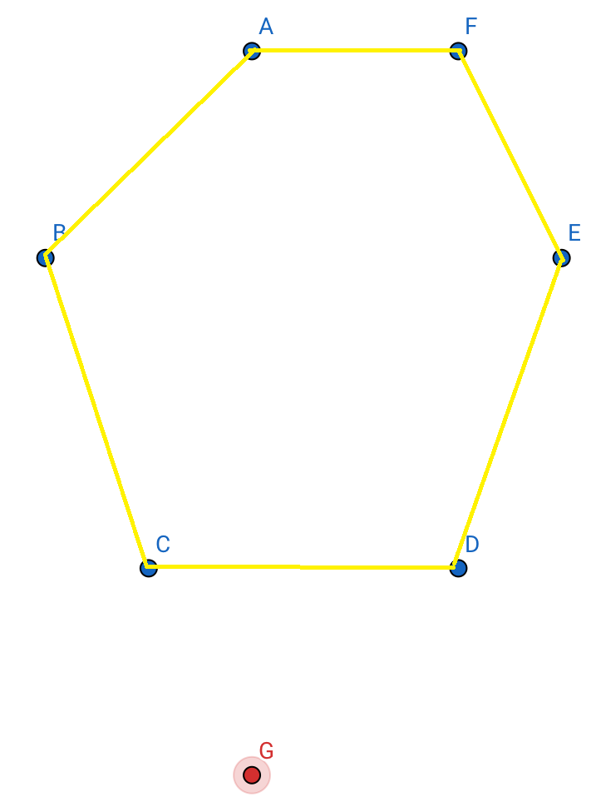
 | Distance from G | Generalized MV Coordinates | Barycentric Coordinates | Generalized Barycentric Coordinates
A | 7 | 7.80453 | -1.83715 | -1.83715
B | 5.4 | 7.14199 | -51.4402 | -51.4402
C | 2.24 | 43.9403 | 131.568 | 131.568
D | 2.83 | 29.3725 | 38.778 | 38.778
E | 5.83 | 5.60733 | -14.7306 | -14.7306
F | 7.3 | 6.13335 | -2.33819 | -2.33819
 |  | 100 | 100 | 100
Total

Slide 11
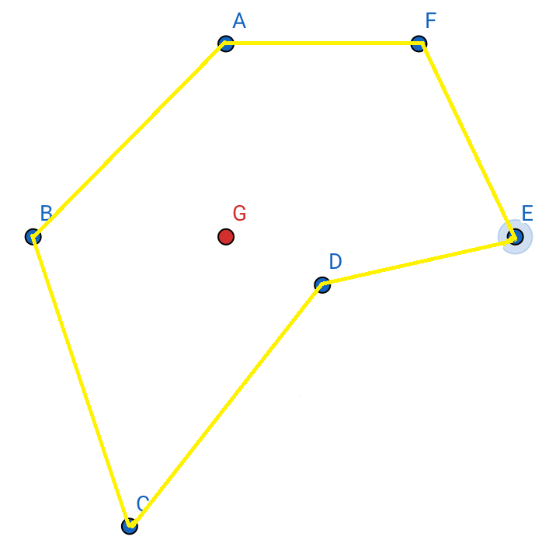
 | Distance from G | Generalized MV Coordinates | Barycentric Coordinates | Generalized Barycentric Coordinates
A | 2 | 19.828 | 28 | 28
B | 2 | 24.1259 | 37.3333 | 37.3333
C | 3.16 | 14.0818 | 45.3333 | 45.3333
D | 1.12 | 27.6731 | -85.3333 | -85.3333
E | 3 | 6.07818 | 56 | 56
F | 2.83 | 8.21302 | 18.6667 | 18.6667
 |  | 100 | 100 | 100
Total

Slide 12
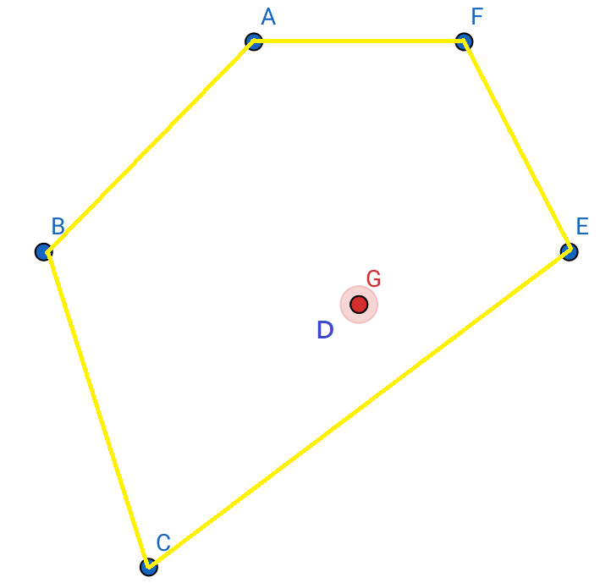
 | Distance from G | Generalized MV Coordinates | Barycentric Coordinates | Generalized Barycentric Coordinates
A | 2.69 | 0 | nan | 0
B | 3.04 | 0 | nan | 0
C | 3.2 | 0 | nan | 0
D | 0 | 100 | nan | 100
E | 2.06 | 0 | nan | 0
F | 2.69 | 0 | nan | 0
 |  | 100 | nan | 100
Total

Slide 13
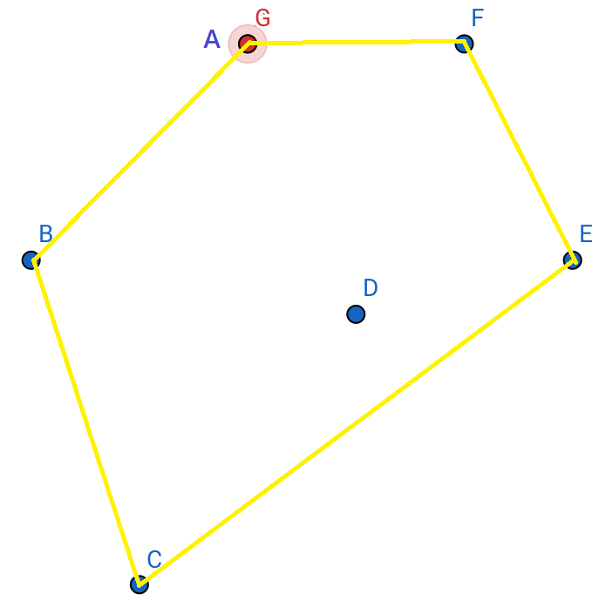
 | Distance from G | Generalized MV Coordinates | Barycentric Coordinates | Generalized Barycentric Coordinates
A | 0 | 100 | nan | 100
B | 2.83 | 0 | nan | 0
C | 5.1 | 0 | 0 | 0
D | 2.69 | 0 | 0 | 0
E | 3.6 | 0 | 0 | 0
F | 2 | 0 | nan | 0
 |  | 100 | nan | 100
Total

Slide 14
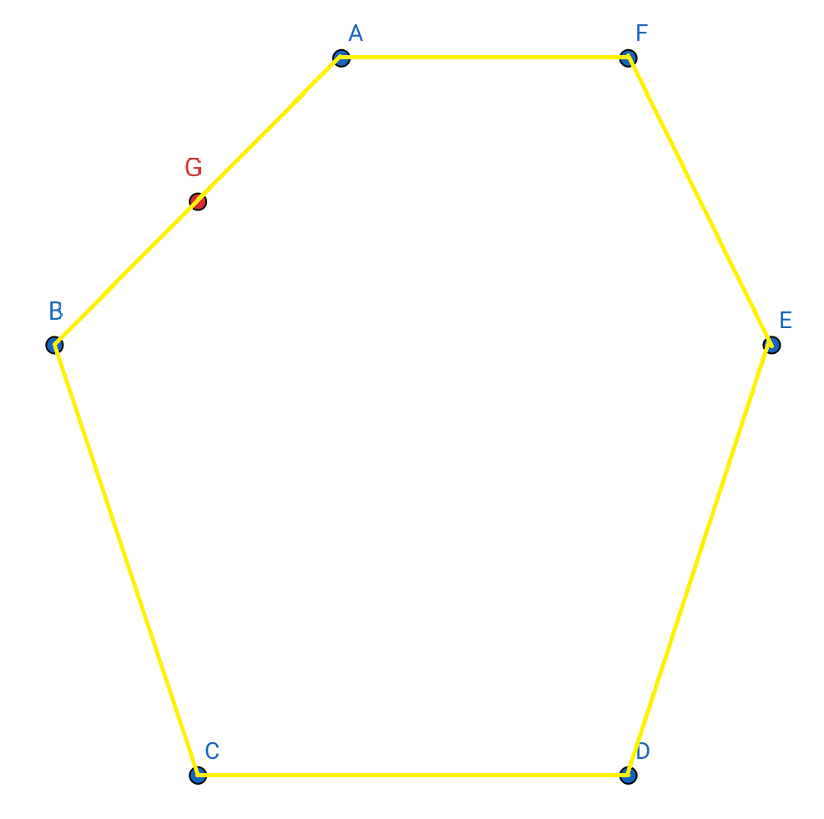
 | Distance from G | Generalized MV Coordinates | Barycentric Coordinates | Generalized Barycentric Coordinates
A | 1.41421 | 50 | nan | 50
B | 1.41421 | 50 | nan | 50
C | 4 | 1.39E-07 ≡ 0 | 0 | 0
D | 5 | 1.03E-07 ≡ 0 | 0 | 0
E | 4.12311 | 1.17E-07 ≡ 0 | 0 | 0
F | 3.16228 | 1.24E-07 ≡ 0 | nan | 0
 |  | 100 | nan | 100
Total

